Slide 1
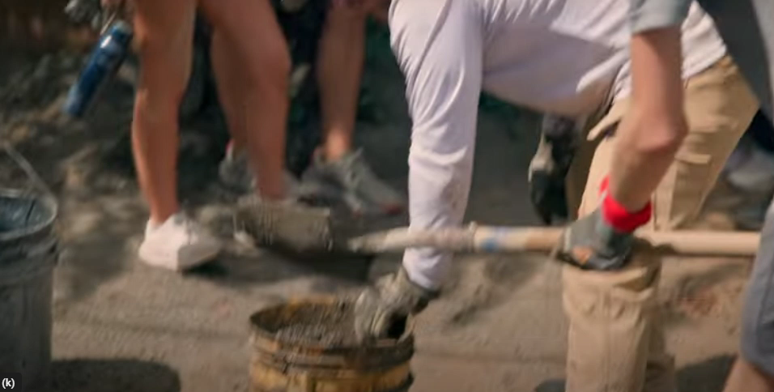
Humanitarian Trip 2026
Nicaragua

Slide 2
Are you interested in making a change in the world? Symmes-D’Arcy McGee High School will be travelling to Nicaragua in February 2026, to volunteer in a remote community in Nicaragua.
Students will work on a week long community project to make a difference. We will also explore great attractions like the city of Granada and enjoy some leisure time surfing.
The Nicaragua Information meeting will be held at lunch in room 222 on Tuesday, May 27.
For more information contact Ms. White at jwhite@wqsb.qc.ca.
You can also see Ms. Ezekiel in room 222 to pick up and drop off your application package.

